Slide 1
Oracle certified Java associate
Lesson 14
Andrei Dragutan

Slide 2
3 parts
Inheritance recap
Super keyword
Final

Slide 3
Inheritance recap.

Slide 4

Syntax of Java Inheritance
class Subclass-name extends Superclass-name
{
//methods and fields
}
The extends keyword indicates that you are making a new class that derives from an existing class. The meaning of "extends" is to increase the functionality.

Slide 5
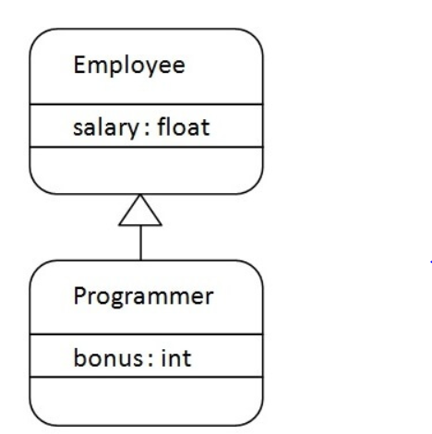
Java Inheritance Example

Slide 6
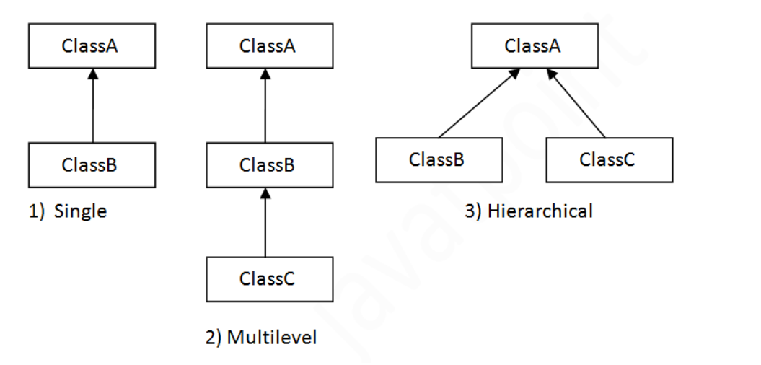
Type of Inheritamce in Java
Note: Multiple inheritance is not supported in java through class.

Slide 7
Method Overriding
If subclass (child class) has the same method as declared in the parent class, it is known as method overriding in java.
In other words, If subclass provides the specific implementation of the method that has been provided by one of its parent class, it is known as method overriding.

Slide 8
Rules for Overriding
method must have same name as in the parent class
method must have same parameter as in the parent class.
must be IS-A relationship (inheritance).

Slide 9
IS-A vs. HAS-A

Slide 10
how to change the parent?
super

Slide 11
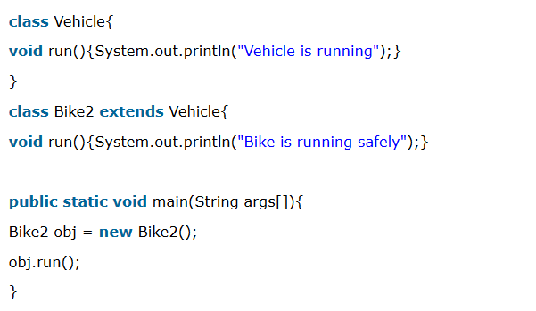
Method Overriding Problem: how to add functionality?

Slide 12
Method Overriding How to add functionality:
class Vehicle {
// Vehicle content
}
class Bike extends Vehicle {
void run() { System.out.println(super.run() + “ Bike”);
}
}

Slide 13
Syntax
Super is used to access class properties, methods of the superclass in the child class methods.
class Bike extends Vehicle {
// properties
void run() { System.out.println(super.run() + “ Bike”);
}
}

Slide 14
Accessing properties
class Vehicle {
protected String name = “Vehicle”;
}
class Bike extends Vehicle {
// properties
void getName() { return super.name + “:” + “Bike”;
}
}

Slide 15
Accessing methods
class Vehicle {
public void run() {
System.out.println(“Vehicle is running”);
}
}
class Bike extends Vehicle {
// properties
public void run() { System.out.println(super.run() + “ Bike”);
}
}

Slide 16
Accessing constructors
class Vehicle {
protected int numberOfWheels;
public Vehicle(int wheelsNumber){
this.numberOfWheels = wheelsNumber; }
}
class Bike extends Vehicle {
public Bike(int numberOfWheels){
super(numberOfWheels);
}
}

Slide 17
override vs overload
declare in the child class a method with the same signature

Slide 18
final

Slide 19
final keyword
Java keyword.
Can be used for methods, classes, attributes.
The result of its usage depends on where it appears

Slide 20
final class
→ Class cannot be extended.
public final class Accountant {
}
class JuniorAccountant extends Accountant{ // error
}

Slide 21
final method
→ Method cannot be changed in subclasses

Slide 22
final attribute
→ Attribute cannot be changed once initialized.
private final int finalAttr = 0;
public void changeFinal(){
finalAttr = 2; // can’t do that
}

Slide 23
final method parameter
→ Method parameter cannot be changed. Received value will be the only value the parameter can have.
public void changeFinal(final int x){
x += 2; // can’t do that
}

Slide 24
final attributes (rules)
Constants must be initialized:
during the declaration
in the constructor
in the initialization blocks

Slide 25
Întrebări, sugestii, propuneri

